Slide 1
The Square Kilometre Array
What does DADI mean to SKA?

Slide 2
Outline
SKA Outline
Project Schedule
SKA Data Flow
SKA Regional Centres and Users

Slide 3
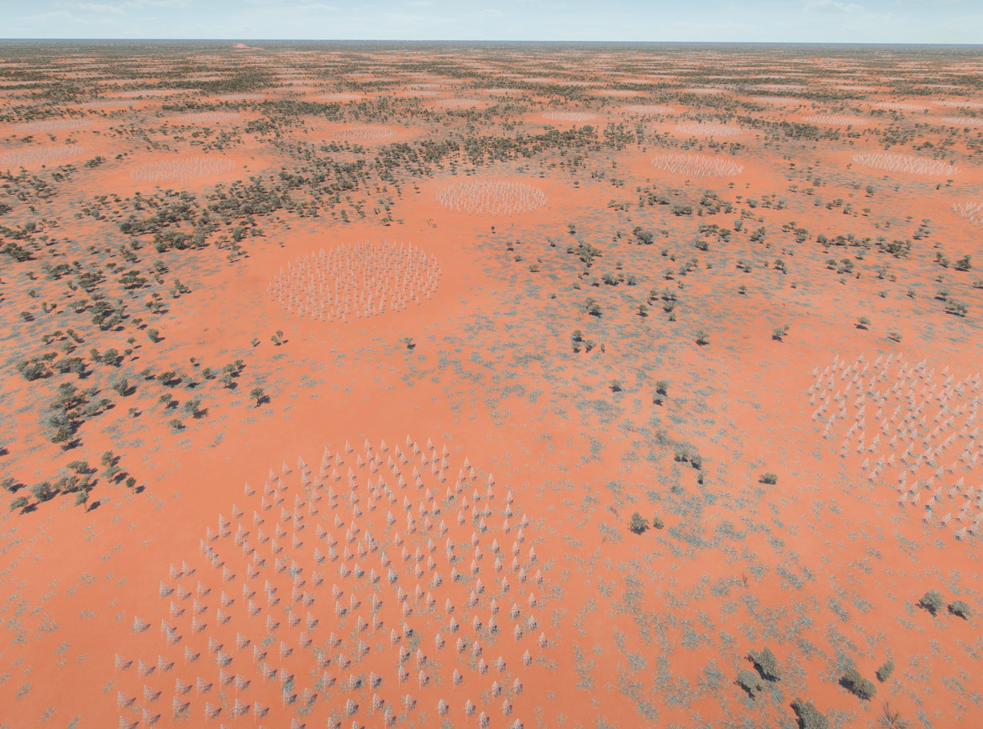
Low-frequency Aperture Array
512 stations of antennas
130,000 Antennas 3m high, spread over radius of 60km
Frequencies 50-350 MHz
(6m-85cm wavelength)

Slide 4
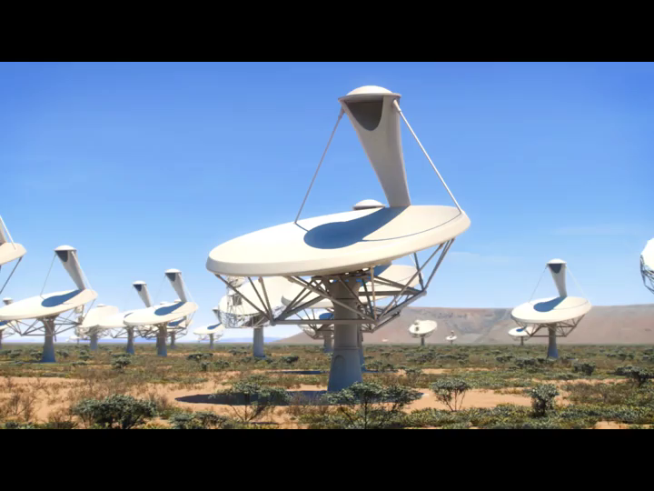
MID Frequency dishes 300MHz-15GHz
197 15m class dishes, including 64 MeerKAT antennas (13.5m)
movie

Slide 5
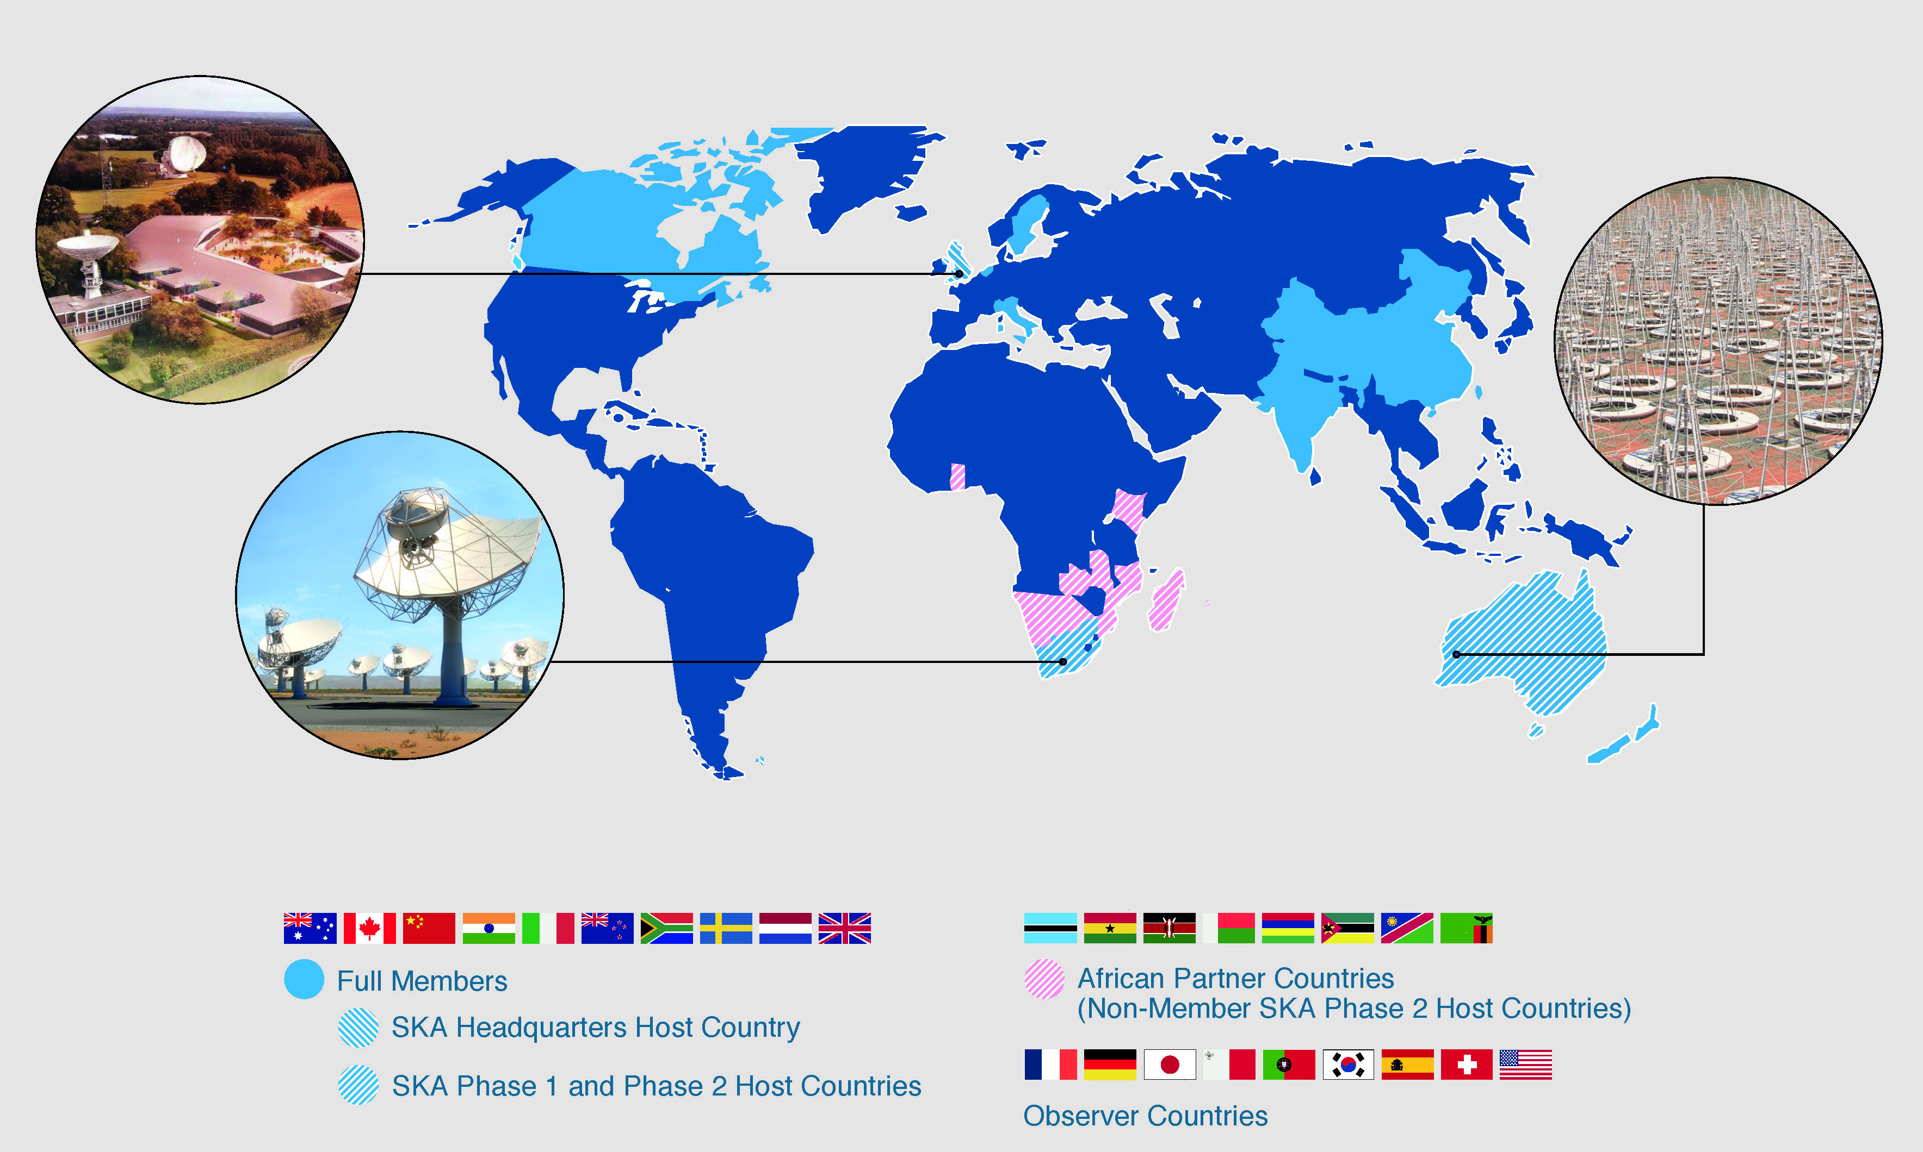
The SKA’s global footprint

Slide 6
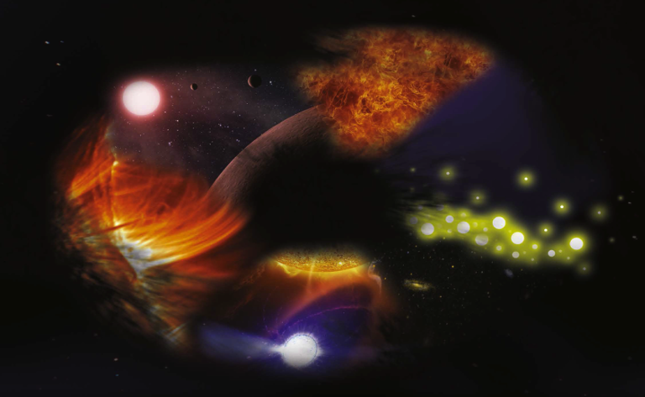
SKA Key Science Drivers:
The history of the Universe
Cosmic Dawn
Testing General Relativity
Galaxy Evolution
Cradle of Life
Cosmology
Cosmic Magnetism
Exploration of the Unknown
Broadest range of science of any facility, worldwide

Slide 7
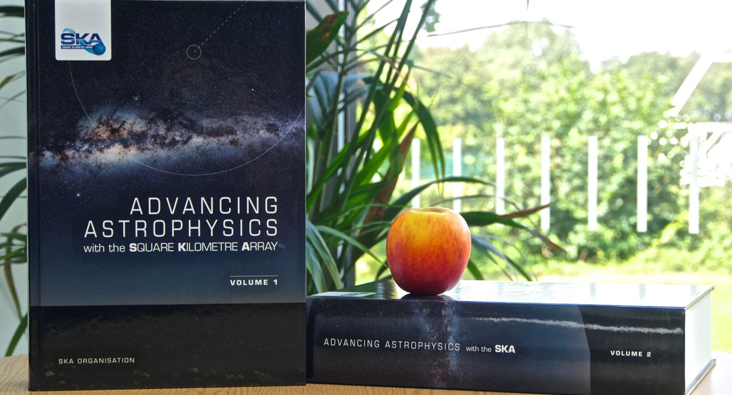
Science Driven Design
SKA Science Case
135 Chapters
more than 1200 authors
31 countries
9-kg of science

Slide 8
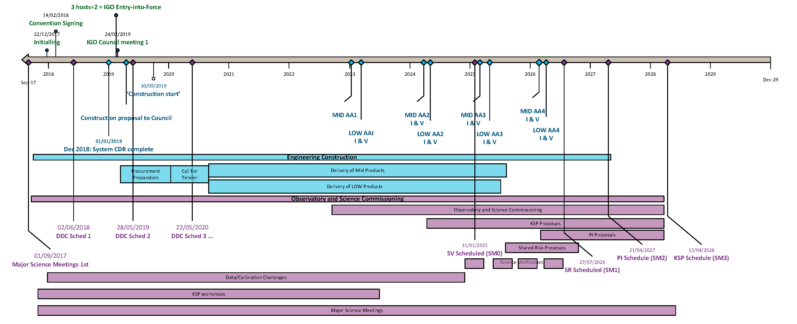
Schedule (subject to change!)
Key Dates :
Signing of convention: Q1-Q2 2018
IGO in operation: early 2019
IGO Council approves construction: early/mid 2019
SKA1 construction procurement begins: ~late 2019
AA1 : 2023 → AA4 : 2026

Slide 9
Data flow challenge

Slide 10
Data flow challenge

Slide 11
Data flow challenge
Memory bandwidth ~ 200 PB/s

Slide 12
A collaborative model for SKA Regional Centres
There are three main factors that lead to a model of a global collaborative alliance of SKA Regional Centres (SRCs)
The science data products that emerge from the SKA observatory are not in the final state required for science analysis and publication
The data volumes are so large that direct delivery to end users is unfeasible
The community of scientists working on SKA science data products will be geographically distributed
Notes:
generation of advanced data products not in scope of project; SDP must maintain throughput matched to input data rate; ⇒ combination & further analysis outside of observatory boundaries
estimate does not account for future "discovery" archive; final data volume of products for each project may exceed that delivered by the observatory; downloading data to local machines/cluster expensive and unfeasible in long term ⇒ take processing to the data
KSPs with 1000s of hrs of observing time will dominate the science programme; large teams drawn from across the membership; need new methods, algorithms and techniques ⇒ driven by the community so they need a platform on which to do this.

Slide 13
A collaborative model for SKA Regional Centres
There are three main factors that lead to a model of a collaborative alliance of SKA Regional Centres (SRCs)
The science data products that emerge from the SKA observatory are not in the final state required for science analysis
The data volumes are so large that direct delivery to end users is unfeasible
The community of scientists working on SKA science data products will be geographically distributed
generation of advanced data products not in scope of project
SDP must maintain throughput matched to input data rate
combination & further analysis of data products outside of observatory boundaries
Notes:
generation of advanced data products not in scope of project; SDP must maintain throughput matched to input data rate; ⇒ combination & further analysis outside of observatory boundaries
estimate does not account for future "discovery" archive; final data volume of products for each project may exceed that delivered by the observatory; downloading data to local machines/cluster expensive and unfeasible in long term ⇒ take processing to the data
KSPs with 1000s of hrs of observing time will dominate the science programme; large teams drawn from across the membership; need new methods, algorithms and techniques ⇒ driven by the community so they need a platform on which to do this.

Slide 14
A collaborative model for SKA Regional Centres
There are three main factors that lead to a model of a collaborative alliance of SKA Regional Centres (SRCs)
The science data products that emerge from the SKA observatory are not in the final state required for science analysis
The data volumes are so large that direct delivery to end users is unfeasible
The community of scientists working on SKA science data products will be geographically distributed
does not account for possible future "discovery" archive
final data volume for each project will exceed that delivered by the observatory
downloading data to local machines/cluster expensive and unfeasible in long term
"take the processing to the data"
Notes:
generation of advanced data products not in scope of project; SDP must maintain throughput matched to input data rate; ⇒ combination & further analysis outside of observatory boundaries
estimate does not account for future "discovery" archive; final data volume of products for each project may exceed that delivered by the observatory; downloading data to local machines/cluster expensive and unfeasible in long term ⇒ take processing to the data
KSPs with 1000s of hrs of observing time will dominate the science programme; large teams drawn from across the membership; need new methods, algorithms and techniques ⇒ driven by the community so they need a platform on which to do this.

Slide 15
A collaborative model for SKA Regional Centres
There are three main factors that lead to a model of a collaborative alliance of SKA Regional Centres (SRCs)
The science data products that emerge from the SKA observatory are not in the final state required for science analysis
The data volumes are so large that direct delivery to end users is unfeasible
The community of scientists working on SKA science data products will be geographically distributed
KSPs with 1000s of hrs of observing time will dominate the science programme
large international teams drawn from across the membership
need new methods, algorithms and techniques
driven by the community so they need a platform on which to do this
Notes:
generation of advanced data products not in scope of project; SDP must maintain throughput matched to input data rate; ⇒ combination & further analysis outside of observatory boundaries
estimate does not account for future "discovery" archive; final data volume of products for each project may exceed that delivered by the observatory; downloading data to local machines/cluster expensive and unfeasible in long term ⇒ take processing to the data
KSPs with 1000s of hrs of observing time will dominate the science programme; large teams drawn from across the membership; need new methods, algorithms and techniques ⇒ driven by the community so they need a platform on which to do this.

Slide 16
A collaborative model for SKA Regional Centres
Observatory Data Products flow from the Science Data Processors in Perth and Cape Town to SKA Regional Centres around the globe.

Slide 17
A collaborative model for SKA Regional Centres
Simplified description
a collaborative alliance
transparent and location agnostic interface to SRCs for users
no SKA user should care where their data products are
all SKA users should be able to access their data products, irrespective of whether their country or region hosts a regional centre

Slide 18
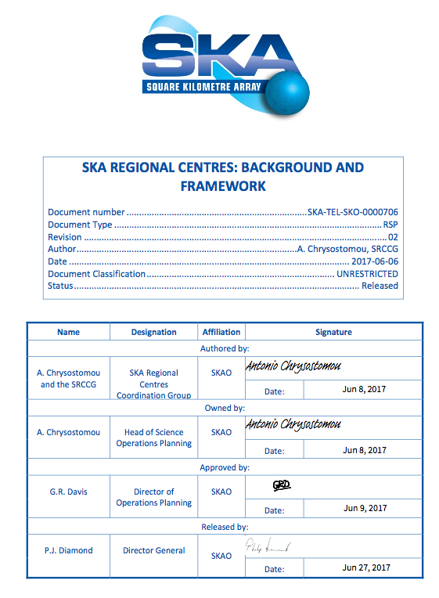
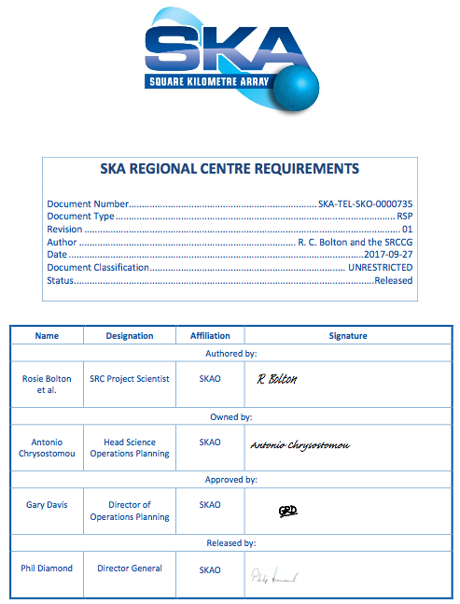
SRC Coordination Group progress
Earlier this year we released Rev01 of the Background and Framework document
updated to Rev02 in Jun17
provides high-level view for interested parties
In Sep17 the first version of SRC requirements were released
A register of risks has been developed and will be regularly reviewed
Timeline of milestones established

Slide 19
Selection of SRC Requirements
Membership:
Membership of the SRC alliance will be awarded if individual prospective SRCs meet and maintain all the criteria set out in appropriate MoUs. The ability of each SRC to meet its criteria, and the criteria themselves will be reviewed annually (TBC).
Interfaces:
Interfaces between each SRC and the SKAO will be compliant with policies set out by the SKAO.
Data policies:
Each SRC will preserve and make available to users, the SKA science data products, in adherence to SKAO data access policies and data security standards
Reproducibility, provenance and workflow:
Each SRC must be capable of saving the complete workflow and provenance associated with any ADP, in such a way that they can be queried, viewed and the associated workflows can be re-used to create new ADPs.

Slide 20
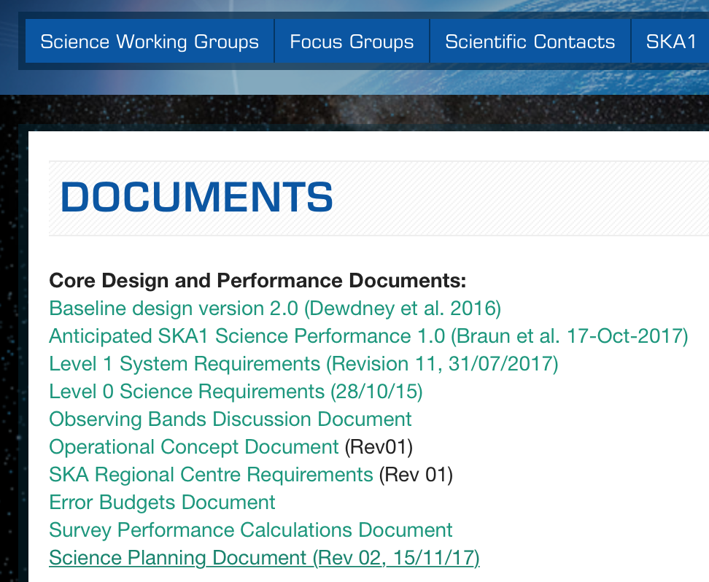
Selection of SRC Requirements
Open access:
The SRCs will enable users to provide public links to SKA science data products in their research publications. Published and non-proprietary data must be publicly available.
Storage capacity:
Collectively the SRCs must provide a bare minimum of 600 PetaBytes (TBC) of storage at the start of SKA1 operations.
These requirements we expect to evolve over time as we learn more from SRC design work from various partners around the globe
https://astronomers.skatelescope.org/documents/

Slide 21
Selection of SRC Goals
Minimise data transfers:
Data products will be located within the SRC alliance such that any transfers between individual SRCs are minimised.
Overall storage capacity:
The SRC alliance is expected to have a net storage capacity of at least 2 Exabytes (TBC) in year 2025, increasing at an annual rate of around 1 Exabytes (TBC).
Growth in processing capacity:
The net processing capacity of the SRC alliance will increase with time, so that it can provide an annual average of 1 (TBC) ExaFlops (peak) by c. 2030
Science archive:
emerged from Nov17 Board meeting
proposal to have an SKA science archive of uniformly processed data products to be made available via data releases

Slide 22
SRC development funding
SKA’s regional centres are not part of SKA Observatory
Several projects already up and running to develop their design
Europe – H2020 AENEAS project (€3M, 2017-2019)
Canada - $10M recently announced
Australia and China – Eridanus project (2017-2020)
South Africa – Regional Centre development including by IDIA, using MeerKAT as stepping stone.

Slide 23
SRC users
Other Observatories
Archive User
Key Science (~70% of telescope time)
SKA PI science
Other science Databases
Notes:
Venn diagram (loosely)
Size of these pieces will change with time,

Slide 24
SRC Users:
Key Science Project team members
Scientists involved in one of the large “Key Science Projects” undertaken for SKA. These large surveys will take thousands of hours to complete and make up ~70% of SKA telescope time on sky.
PI team members
Smaller projects, that can be completed within a single observing cycle – typically a few tens to one hundred hours sky time.
Both the above will need support to get projects through to science-ready data products.
Archive Users
Other Observatories
Other Science Databases

Slide 25
SRC Users:
Key Science Project team members
PI team members
Archive Users
Astronomers from all disciplines who want to extract information from public products in the archive. They may not have written, or ever intend to write an SKA proposal.
Other Observatories
Users of data from other observatories may wish to cross-match catalogues or perform multi-wavelength source detection, or get overall statistics from combined datasets. Other facilities may want to site their public archives within the SKA Regional Centre framework, or, conversely, portions of SKA’s archive might be hosted as part of other observatories’ archive…
Other Science Databases
Connection to EOSC – why stop at astronomy?...

Slide 26
What is an SKA Regional Centre?
It’s a collection of hardware and software infrastructure associated with a particular country or region
It presents itself to the user as a single virtual entity, as part of a federated collection of these virtual entities
It’s made from whatever resources can be gathered together.
There must be dedicated long term, stable storage identified with guaranteed availability.
Significant batch processing computing resources are also required, though these could be useful even with partial availability
Interactive processing for visualisation and data discovery must be available reliably.

Slide 27
SKA and DADI
SRCs must provide data access and discovery as a primary function.
SKA’s data products will be VO compliant.
Additional products (Advanced Data Products) generated within the Regional Centres will follow the same rules and become part of the archive landscape.
Interoperability of the SKA Regional Centers is key – we want a shared global SKA archive to avoid duplication of data products unless desired. We want users to be unaffected by the physical location of the data they are working with, as well as the user’s own location – need a Gateway.
A big measure of the success will be if non-radio astronomers can easily and successfully access and use the SKA archive = DADI

